Slide 1
Implementing Convolutional Neural Network and Neural Style Transfer from Scratch
Presented by: AmirReza Azari

Slide 2
Context
The Problem
CNN
NST
VGG19
Losses
Results
Conclusion and Future work

Slide 3
The Problem
Problem:
Implementing CNN from scratch
Implementing NST from scratch

Slide 4
What is a CNN?
A type of deep learning model specialized for image & spatial data
Inspired by the human visual system

Slide 5
Why CNNs?
Automatically learns features (edges, shapes, objects)
Reduces manual feature engineering
Excellent performance in:
Image classification
Object detection
Face recognition

Slide 6
CNN Architecture Overview
Main building blocks:
Convolution Layer
Pooling Layer
Fully Connected Layer
Output Layer

Slide 7
What is NST?
AI technique that combines the content of one image with the style of another image
Example: A photo painted in Van Gogh’s style

Slide 8
Why Neural Style Transfer?
Creates artistic images with deep learning
Bridges art and technology
Applications:
Digital art
Photography filters
Entertainment & design

Slide 9
Key Idea
Two inputs:
Content image (e.g., your photo)
Style image (e.g., Van Gogh’s Starry Night)
Output: A new image = Content + Style

Slide 10
Underlying Technology
Based on Convolutional Neural Networks (CNNs)
CNN layers capture:
Lower layers → edges, textures (style)
Higher layers → objects, shapes (content)

Slide 11
The Loss Function
Total loss = Content Loss + Style Loss (+ sometimes TV loss)
Optimizes image to minimize this loss
Balances “looking like the photo” vs “looking like the painting”

Slide 12
End-to-End Process
Take content & style images
Pass through CNN (like VGG-19)
Compute losses
Iteratively update the generated image
Final stylized image

Slide 13
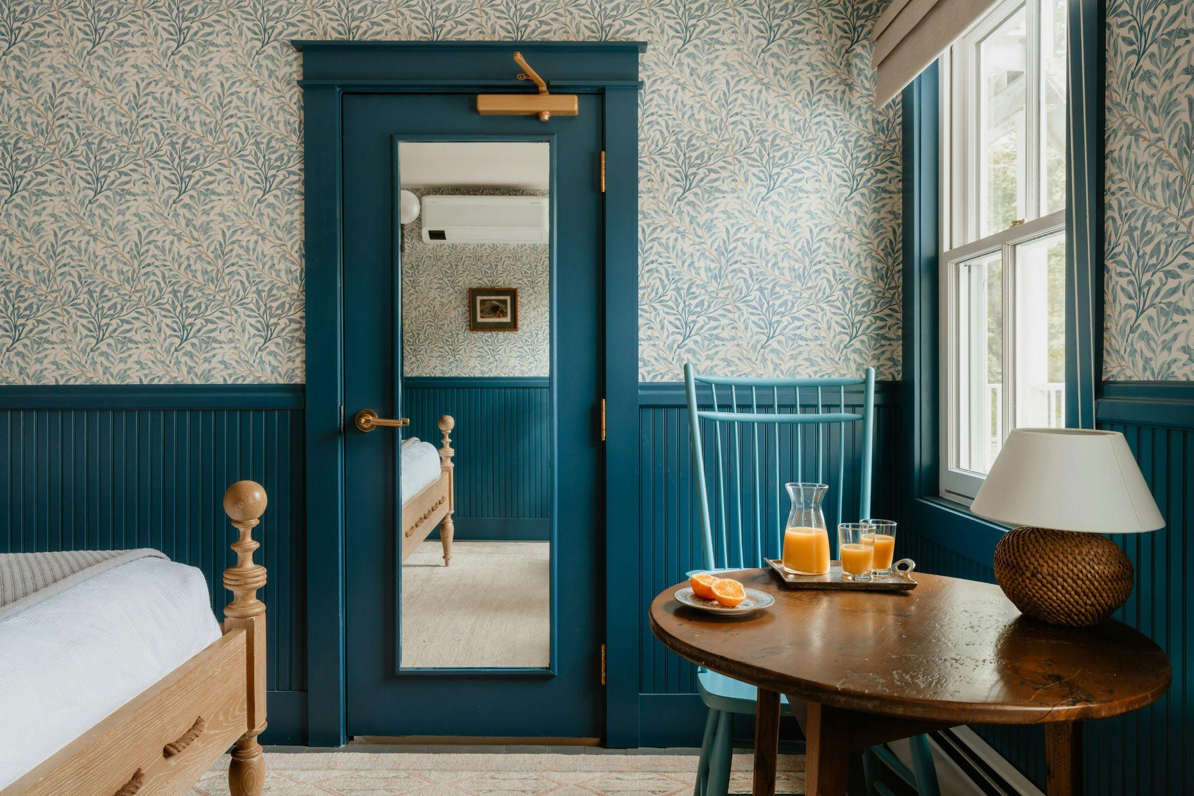
Results

Slide 14
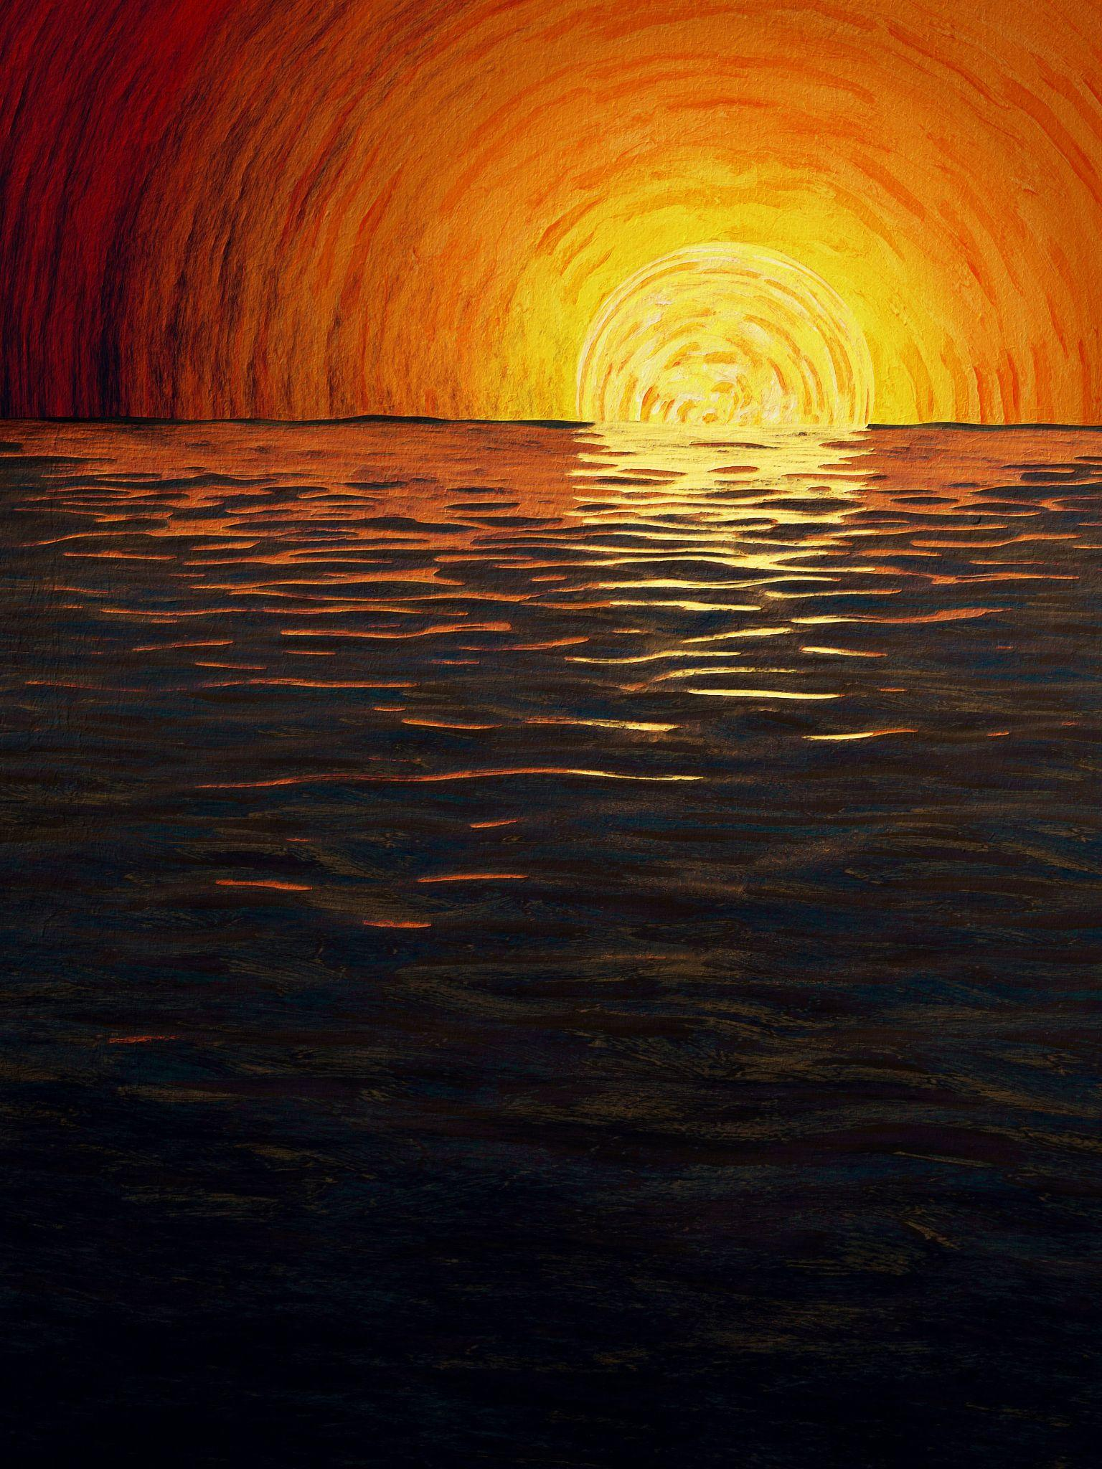
Results

Slide 15
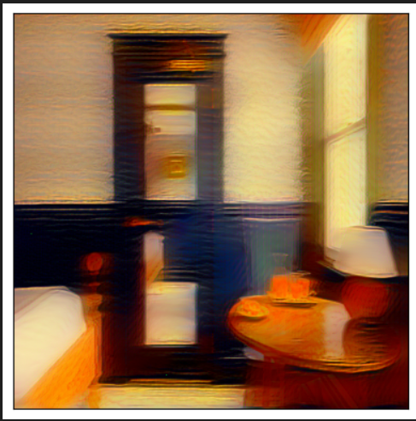
Results

Slide 16
Conclusion
Convolutional Neural Networks (CNNs):
Core architecture for computer vision
Automatically extracts features (edges → objects)
Powers tasks like classification, detection, and recognition
Neural Style Transfer (NST):
Creative application of CNNs
Blends content (structure) with style (textures, colors)
Bridges deep learning and artistic expression
Takeaway:
CNNs provide the foundation
NST shows how these models enable both practical and creative applications of AI

Slide 17
Future Work
For CNNs:
Improve efficiency with lightweight models (e.g., MobileNet, EfficientNet)
Better explainability and interpretability of learned features
Integration with multimodal AI (vision + text + audio)
Applications in medical imaging, robotics, autonomous systems
For NST:
Faster real-time style transfer with more stable outputs
Multi-style & dynamic blending in a single model
Style transfer for videos & 3D content
Applications in creative industries, AR/VR, gaming

Slide 18
Thank you!

